Slide 1
What is PBIS? Tier 1 - Universal Supports
Developed by California State University and Los Angeles Unified School District

Slide 2
3 Tier-One Evidence-based Positive Behavior Support Interventions
1. Transitions: Smooth transitions can increase instructional time and reduce problem behavior (Mcintosh et al., 2004)
2. Effective Praise: Praise statements have shown to improve academic and behavior outcomes for students (Sutherland et al., 2000)
3. Choice Making: Providing opportunities to make choices can serve as an intervention for decreasing problem behavior (Shogren et al., 2004)

Slide 3
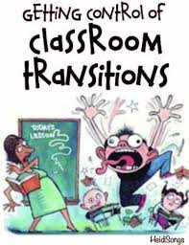
Transitions: Getting Control of Classroom Transitions
Transitions require students to stop one activity, perform a chain of “transition tasks,” and then begin a new activity, all without breaking classroom rules
Transitions can be particularly difficult for students with autism spectrum disorder, ADHD, and other behavioral disorders
Teaching expected behaviors for transition times can increase appropriate behavior
(Mcintosh et al., 2004)

Slide 4
Transitions: Establishing Routines
Teaching routines: Establishing routines will help students know expected behaviors for your classroom
entering and exiting the classroom
Example Board image
moving from one area to another
changing from one activity to another
Binder Example of daily Schedule
completing an activity rotations
Example activities when “I’m Done”
turning in homework/ classwork
writing down homework
Online Stop Watch

Slide 5
Techniques for Teaching Effective Transitions
Teaching Routines and Signals: Model, Practice, Feedback
Pre-corrections: Quick reminders of expected behaviors before transition
Reinforcement/Redirection: Praise for appropriate behaviors, ignore or redirect inappropriate behaviors
Supervise: Monitor transitions
(Mcintosh et al., 2004)

Slide 6
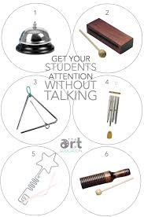
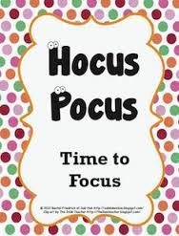
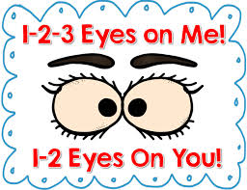
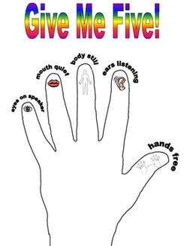
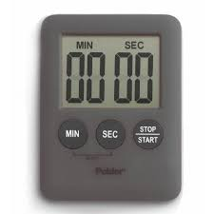
Signals : Attention-getters to prepare for transitions

Slide 7
Effective Praise
Defined as:
“Teacher-initiated statements that convey to children the specific academic or social behaviors in which the teachers would like to see students continually engage.” (Conroy et al., 2009)
Notes:
Rosalinda

Slide 8
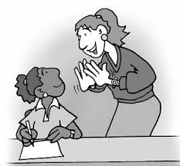
Effective Praise: Implementation
Conroy et al., 2009
Praise
contingent on student behavior
focus on improvements and effort
expected behaviors
compliance
even if initially noncompliant
Notes:
Rosalinda

Slide 9
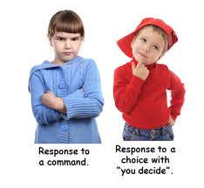
Choice Making
Allows the student to have some control over the environment
Teacher offers choices
choices within task
Which math sheet do you want to complete first? Do you want to do odd or even questions in workbook?
choices related to environment
Do you want to work at your desk or the kidney table? Do you want to sit in the yellow chair or the blue chair?
choices about order
Read first or journal first?
List of May do’s/Must Do’s upon task completion or in lieu of a task.
Notes:
Students do not negotiate choices to be made

Slide 10
ACTIVITY: Behavior Challenges in the Classroom
What is one behavior challenge that you’ve experienced in your classroom? (write it down on the index card provided)
1. Could the behavior described on the card distributed to you be addressed through one of the three positive behavior intervention supports discussed?
2. What are some ways that other teachers might respond?
Notes:
At this time, redistribute the cards and have them consider someone else’s behavior challenge. We will collect the cards along with their exit ticket at the end of the session

