Slide 1
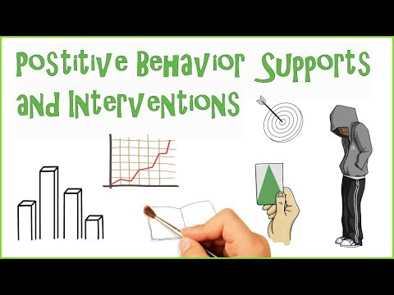
What is PBIS?
Tier 2-3 Targeted and Intensive Supports
Developed by California State University and Los Angeles Unified School District

Slide 2
Tier 2 involves focused and intensive small group interventions Tier 3 involves more intensive, individualized support
Tier 3
Intensive
Few Students
Tier 2
Strategies for Some Students
Tier 1
Strategies for All Students
Universal

Slide 3
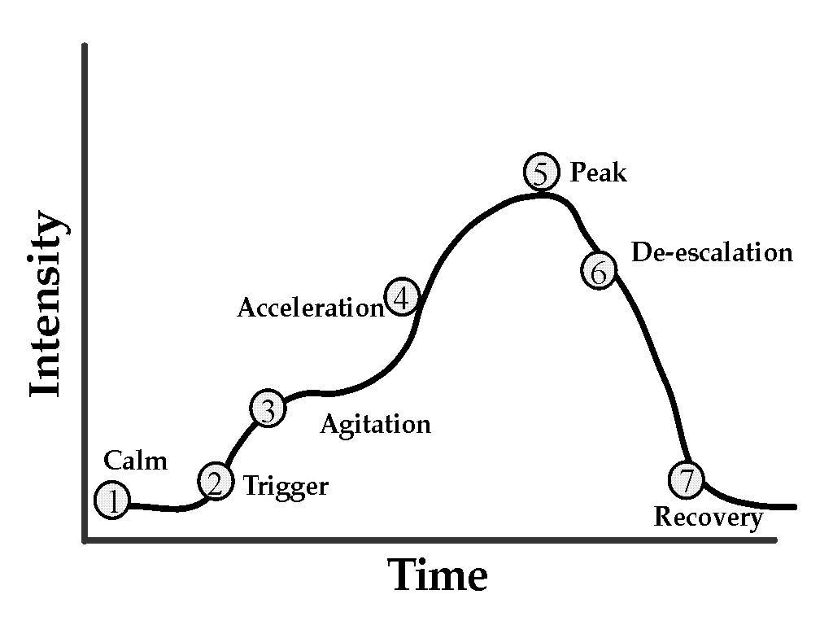
Common Cycle of Behavior Escalation
FROM: The work of Geoff Colvin
Notes:
*

Slide 4
Develop a plan and strategies
1.Prevent problems
2.Teach something different
3.Manage what happens after

Slide 5
Develop a plan and strategies: 1. Prevent problems
Minimize negative situations
Remove unnecessary distractions
Front load the student- let them know the expectations in advance
Provide enough time with activity
Make difficult circumstances better
Choices (order of task- menu options, listen to music while doing work, time)
Be aware of your communication (tone, body language, and expressions)

Slide 6
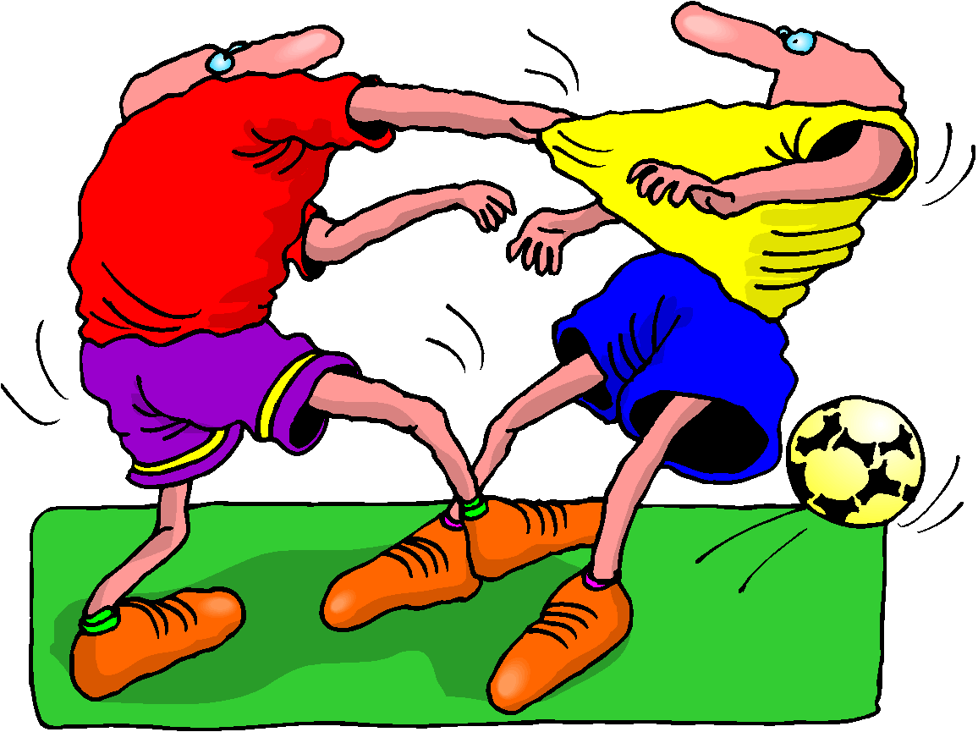
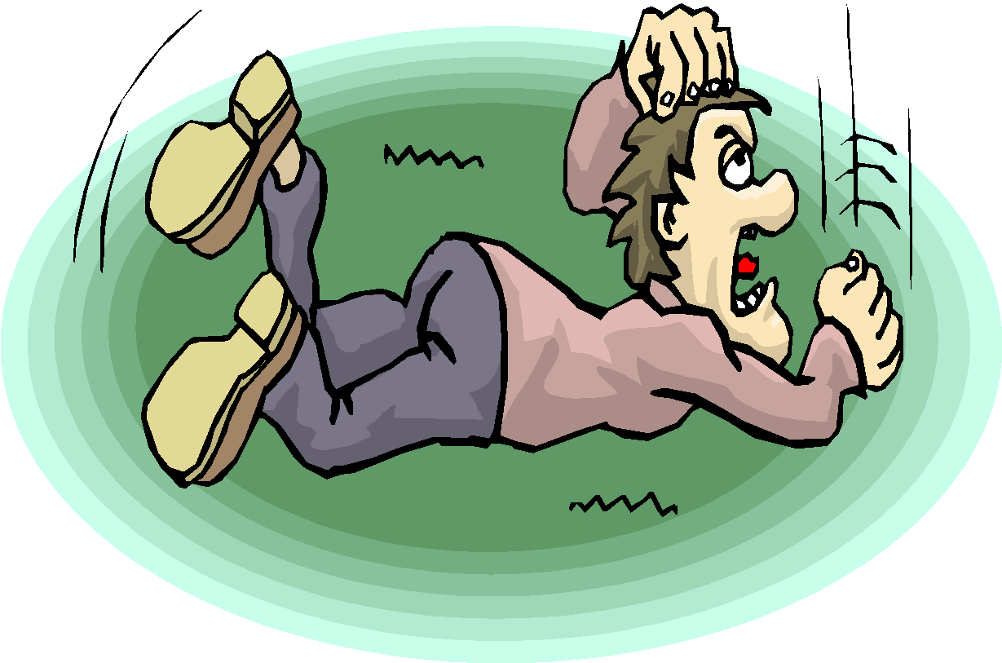
Develop a plan and strategies 2. Teach something different
What else can my student do to get what he or she needs that is more appropriate and just as effective?
Replacement behavior has to be just as efficient and effective as the problem behavior

Slide 7
What can they do instead of the problem behavior?
Screams when frustrated with an activity.
Instead, will
Ask for a break
Divide tasks into smaller steps
Hits when someone is playing with their toy.
Instead, will
Request the item, take turns, plan to use the item later

Slide 8
Teaching New Skills
Teach through multiple examples
Give frequent practice opportunities
Provide useful corrections & lots of positive feedback
Monitor for success
Model expected behaviors

Slide 9
Here Are a Few More Strategies …
Avoid using a question format
Reduce Distance
Reduce Loudness of Request
Give a START request rather than a STOP request
Make Non-emotional requests instead of Emotional requests
Consistently Reinforce Compliance
Notes:
*

Slide 10
Develop a plan and strategies: 3. Manage what happens after
Be calm, consistent, and specific.
Positive Consequences such as earned privileges, reward systems are visual.
Goal | Monday | Tuesday | Wednesday | Thursday | Friday
Complete classwork: Earns 5 minutes of free choice time. | X | X | X | X | X

Slide 11
Activity
“Monica is not completing her work during math time. When it’s time to do her independent work, she starts looking through her pencil box, walking around the classroom, and talking to her friends. Then she’s unable to complete her work which makes it difficult for me to focus on the other students who are on-task.”
What can you frontload to prevent the student from engaging in this behavior?
What strategy could you teach the student to replace the undesirable behavior?
What would you do to reinforce the positive behavior?

